Slide 1
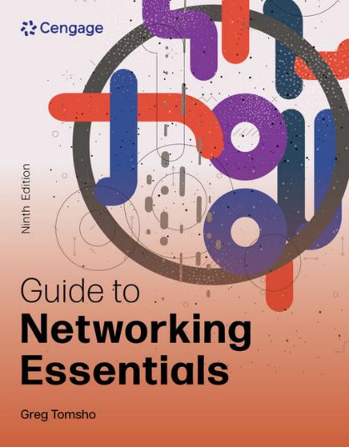
Guide to Networking Essentials, 9e
Chapter 4: Network Media
.

Slide 2
Chapter Objectives
By the end of this chapter, you should be able to:
Define the primary cable types used in copper network cabling
Describe the characteristics of the major types of fiber-optic network cabling
Explain the technologies used for wireless networking
Select the proper media for a given application

Slide 3
Criteria for Choosing Network Media (1 of 5)
Bandwidth Rating
Bandwidth is the number of bits per second that can be transmitted across a medium
A factor determining bandwidth is how bit signals are represented on the medium (called encoding)
When possible, choose a cabling category that’s compatible with the standard you want to implement now but will support growth and faster speeds

Slide 4
Criteria for Choosing Network Media (2 of 5)
Maximum Segment Length
A cable segment is a length of cable between two network devices
Intermediate passive devices, such as wall jacks, are considered part of the total segment length
Each cable type can transport data only so far before its signals begin to weaken beyond what can be read by a receiving device (called attenuation)

Slide 5
Criteria for Choosing Network Media (3 of 5)
Interference to electrical signals on copper media comes in the form of electromagnetic interference (EMI) and radio frequency interference (RFI)
Motors, transformers, fluorescent lights and other sources of intense electrical activity can emit both EMI and RFI.
RFI can also affect wireless networks
Crosstalk is interference one wire generates on another wire when both wires are in a bundle
Copper wire is susceptible to electronic eavesdropping
Fiber-optic media carries light signals and is not susceptible to EMI

Slide 6
Criteria for Choosing Network Media (4 of 5)
Cable Grade
Cables ran between a false ceiling and the true ceiling (plenum) must be plenum-rated
UTP cabling is marked as communications riser (CMR) or communications plenum (CMP)
CMR can only be used for building risers or in cable trays and CMP is suitable for use in plenum spaces
Connection Hardware
Every type of cable has connectors that influence the kinds of hardware the cable can connect to

Slide 7
Criteria for Choosing Network Media (5 of 5)
Other Media Considerations
Ease of installation
Testability
Total cost

Slide 8
Coaxial and Twinax Cable
Coaxial cable is often called “coax” for short
It is inexpensive and easy to install, but started to phase out in the early 1990’s
Today, coaxial cable is used primarily in connecting a cable modem to the wall outlet your cable TV/Internet provider installs
Twinax cable is used in high-speed connections over short distances
It can support Ethernet speeds up to 100 Gbps at a maximum distance of 15 meters
Used in datacenters connecting storage devices and servers to switches

Slide 9
Twisted-Pair Cable (1 of 9)
Twisted-pair (TP) cable comes in two types: unshielded and shielded (UTP and STP)
TP consists of one or more pairs of insulated strands of copper wires twisted around one another and housed in an outer jacket
Twists are necessary to improve resistance to crosstalk from wires and EMI from outside sources
The more twists per unit length, the better resistance to EMI and crosstalk
More expensive TP is twisted more than less expensive and provides a better pathway for higher bandwidth networks

Slide 10
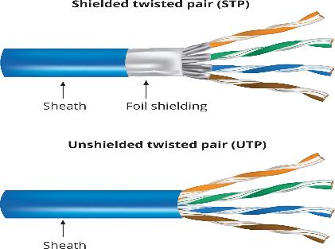
Twisted-Pair Cable (2 of 9)
Figure 4-1 STP and UTP cable

Slide 11
Twisted-Pair Cable (3 of 9)
Unshielded Twisted-Pair Cable consists of four pairs of insulated wires
It is rated according to categories devised by the Telecommunications Industry Association (TIA) and Electronic Industries Alliance (EIA) and American National Standards Institutes (ANSI)
Categories 1-6a and Category 8 are accepted in US
Two additional categories aren’t yet TIA/EIA standards
Europe has accepted Category 7 and 7a, which specify that each wire pair is shielded
Categories 5e and 6 are the most installed categories of UTP cabling

Slide 12
Twisted-Pair Cable (4 of 9)
Table 4-1 Category 5e and 6 UTP cabling characteristics
Characteristic | Value
Maximum cable length | 100 m (328 ft)
Bandwidth | Up to 1000 Mbps
Bend radius | Minimum four times the cable diameter of 1 inch
Installation and maintenance | Easy to install, no need to reroute; the most flexible
Cost | Least expensive of all cabling options
Connector type | RJ-45 plug, RJ-45 jack, and patch panels
Security | Moderately susceptible to eavesdropping
Interference rating | Susceptible to EMI and crosstalk

Slide 13
Twisted-Pair Cable (5 of 9)
Shielded Twisted-Pair (STP) cable includes shielding to reduce crosstalk and interference
STP has a wire braid inside the sheath material or a foil wrap
It is best to use STP in electrically noisy environments or for very high-bandwidth applications
Common STP versions found in networks today include Cat 5e, Cat 6, and Cat 6a
STP is sometimes referred to as “foiled twisted pair (FTP)”

Slide 14
Twisted-Pair Cable (6 of 9)
Twisted-Pair Cable Plant Components
RJ-45 Connectors—most STP and UTP cabling uses RJ-45 connectors (RJ-45 plug) to connect computers to hubs, switches, and RJ-45 jacks
Patch cable—a short cable for connecting a computer to an RJ-45 wall jack or connecting a patch-panel port to a switch or hub
RJ-45 jacks—an RJ-45 jack is what you plug an RJ-45 connector into when the computer is in a work area away from hubs and switches
RJ-45 jacks are usually placed behind wall plates when cables are run inside walls but can be recessed into the floor or placed in surface-mounted boxes

Slide 15
Twisted-Pair Cable (7 of 9)
Twisted-Pair Cable Plant Components
Patch Panels—used to terminate long runs of cable from where the computers are to the wiring closet (where the switches and hubs are)
Distribution racks—hold network equipment such as routers and switches, plus patch panels and rack-mounted servers
Also called 19” racks because the upright rails are 19” apart

Slide 16
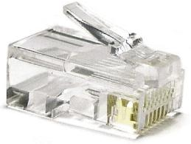
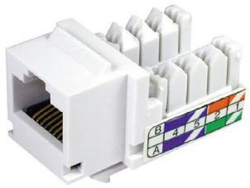
Twisted-Pair Cable (8 of 9)
Figure 4-3 An RJ-45 plug
Figure 4-5 An RJ-45 jack

Slide 17
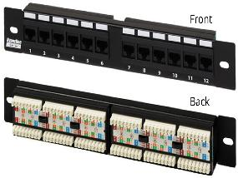
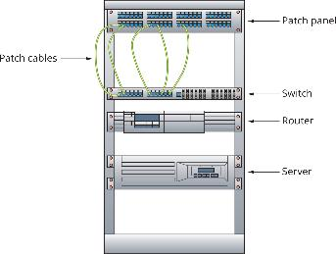
Twisted-Pair Cable (9 of 9)
Figure 4-6 Patch panel front and back
Figure 4-7 A distribution rack

Slide 18
Structured Cabling: Managing and Installing a UTP Cable Plant (1 of 12)
Structured cabling specifies how cabling should be organized, regardless of the media type or network architecture
Large networks typically use most or all of these components:
Work area
Horizontal wiring
Telecommunication closets
Equipment rooms
Backbone or vertical wiring
Entrance facilities

Slide 19
Structured Cabling: Managing and Installing a UTP Cable Plant (2 of 12)
The work area is where workstations and other user devices are located
Faceplates and wall jacks are installed in the work area and patch cables connect computers and printers to wall jacks
Horizontal wiring runs from the work area’s wall jack to the telecommunication closet
Wiring from the wall jack to the patch panel should be no longer than 90 meters (plus 10 meters for patch cables)

Slide 20
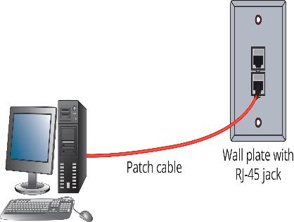
Structured Cabling: Managing and Installing a UTP Cable Plant (3 of 12)
Figure 4-8 Work area components

Slide 21
Structured Cabling: Managing and Installing a UTP Cable Plant (4 of 12)
The telecommunications closet (TC) provides connectivity to computer equipment in the nearby work area
A TC that houses the cabling and devices for work area computers is referred to as an intermediate distribution frame (IDF)
The equipment room houses servers, routers, switches, and other major network equipment and serves as a connection point for backbone cabling
An equipment room that’s the connection point between IDFs is called a main distribution frame (MDF) or “main cross-connect”

Slide 22
Structured Cabling: Managing and Installing a UTP Cable Plant (5 of 12)
Backbone cabling interconnects IDFs and MDFs
This cabling runs between floors or wings of a building and between buildings
It is often fiber-optic cable but can also be UTP if the distance between TCs is less than 90 meters
Entrance Facility is the location of the cabling and equipment that connects a corporate network to a third-party telecommunications provider
It can also serve as an equipment room and the main cross-connect for all backbone cabling

Slide 23
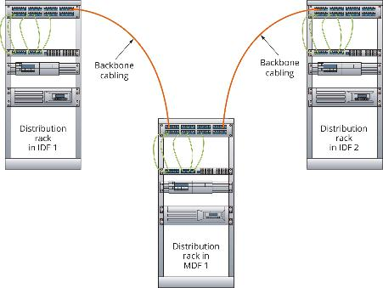
Structured Cabling: Managing and Installing a UTP Cable Plant (6 of 12)
Figure 4-10 Backbone cabling connecting IDFs and MDFs

Slide 24
Structured Cabling: Managing and Installing a UTP Cable Plant (7 of 12)
Installing UTP Cabling
Cable termination means putting RJ-45 plugs on the ends of cable or punching down wires into terminal blocks on a jack or patch panel
When making a cable or terminating a cable at a jack or patch panel it is important to get the colored wires arranged in the correct order
There are two standards: TIA/EIA 568A and TIA/EIA 568B (see Figure 4-12 on the following slide)

Slide 25
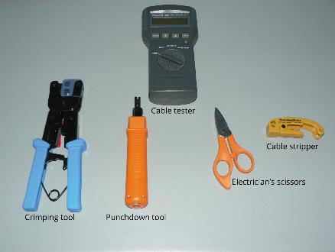
Structured Cabling: Managing and Installing a UTP Cable Plant (8 of 12)
Figure 4-11 Cable installation and termination tools

Slide 26
Structured Cabling: Managing and Installing a UTP Cable Plant (9 of 12)
Standard patch cables are called straight-through cables (same wiring standard on both ends)
Crossover cables use 568A standard on one side of the cable and 568B standard on the other side
This type of cable crosses the transmit and receive wires so that transmit on one end connects to receive on the other
This type of cable is often needed when you connect two devices of the same type to one another
For a 1000BaseT crossover cable, you have to cross the blue and brown pins because they’re used in 1000BaseT

Slide 27
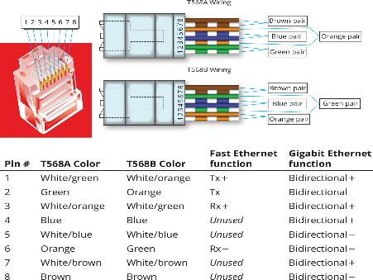
Structured Cabling: Managing and Installing a UTP Cable Plant (10 of 12)
Figure 4-12 TIA/EIA 568A and 568B cable pinouts

Slide 28
Structured Cabling: Managing and Installing a UTP Cable Plant (11 of 12)
Network devices connecting with RJ-45 plugs are classified as medium dependent interface (MDI) devices or MDI crossed (MDI-X) devices
MDI devices transmit on pins 1 and 2 and receive on pins 3 and 6
MDI-X devices receive on pins 1 and 2 and transmit on pins 3 and 6
Usually hubs and switches are examples
When two switches need to be connected, you use a crossover cable so that transmit and receive wires get crossed
Some devices have “auto-sensing” (Auto-MDI-X) ports that can detect whether you are trying to connect transmit wires to transmit wires

Slide 29

Structured Cabling: Managing and Installing a UTP Cable Plant (12 of 12)
Why Two Transmit and Two Receive Wires?
One wire pair is used for transmit (labeled transmit+/transmit-) and one pair for receive (labeled receive+/receive-)
The plus and minus symbols indicate that the wires carry a positive or a negative signal
This differential signal mitigates the effect of crosstalk and noise on the cable
https://www.yout-ube.com/watch?v=gzVe_GnbifI Fiber - copper

Slide 30
Knowledge Check Activity 4-1
Part 2
To support 1000BaseT Ethernet, what is the minimum cabling category you should use?
a. Category 4
b. Category 5e
c. Category 6a
d. Category 7

Slide 31
Knowledge Check Activity 4-1: Answer
To support 1000BaseT Ethernet, what is the minimum cabling category you should use?
Answer: b. Category 5e
Explanation: Category 5 cabling can be used in Gigabit Ethernet (1000BaseT), but Cat 5e is the minimum recommendation because of the additional tests required for it.

Slide 32
Fiber-Optic Network Cabling
With fiber-optic cable, bits are transmitted as pulses of light instead of electricity
Makes it immune to electrical interference and eavesdropping
Composition of fiber-optic cable:
A slender cylinder of glass fiber called the core is surrounded by a concentric layer of glass called the cladding
Fiber is then jacketed in a thin transparent plastic material called the buffer
In most cases, each fiber-optic strand carries data in only one direction

Slide 33
Fiber-Optic Connectors (1 of 2)
Types of fiber-optic connectors include the following:
Straight tip (ST)
Straight connection (SC)
Locking connection (LC)
Mechanical transfer registered jack (MT-RJ)
Fiber channel or ferrule connector (FC)
Medium interface connector (MIC)
Subminiature type A (SMA)

Slide 34
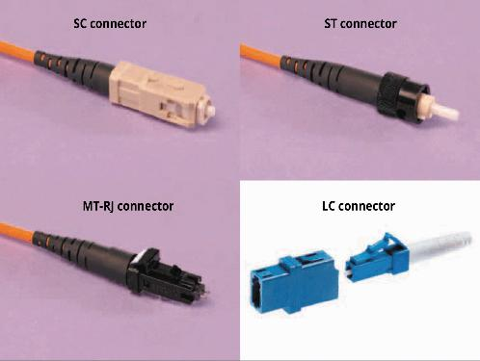
Fiber-Optic Connectors (2 of 2)
Figure 4-19 Fiber-optic connectors

Slide 35
Fiber-Optic Installation
Installing fiber-optic networks is more difficult than installing copper media
However, advances in connector technology are closing the gap
Connectors and test equipment required for termination are still more expensive than copper
There are many methods for terminating fiber-optic cables because of the many connectors and cable types available
Installation details are beyond the scope of this book

Slide 36
Fiber-Optic Cable Types
Single-mode fiber (SMF):
Includes a single, small-diameter fiber at the core (8 microns)
Works with laser-based emitters and spans the longest distances
Used in higher-bandwidth applications
Multimode fiber (MMF) :
Larger diameter fiber at the core (50 and 62.5 microns) and costs less than SMF
Works with lower-power light emitting diodes (LEDs)
Spans shorter distances

Slide 37
Cable-Testing Equipment
Common tools for testing and troubleshooting wired networks:
Cable certifier
Basic cable tester
Tone generator
Time domain reflectometer (TDR)
Multimeter
Optical power meter (OPM)

Slide 38
Wireless Networking
Wireless networks are often used with wired networks to interconnect geographically dispersed LANs or groups of mobile users with wired servers and resources on a wired LAN
Even in small networks with workstations connecting to a wireless AP or router, the AP or router usually connects to the Internet via a wired connection to a cable modem

Slide 39
Wireless Benefits (1 of 2)
Wireless networking can offer the following capabilities:
Create temporary connections to wired networks
Establish backup or contingency connectivity for existing wired networks
Extend a network’s span beyond the reach of wire-based or fiber-optic cabling, especially in older buildings where rewiring might be expensive
Allow businesses to provide customers with wireless networking easily, offering a service that gets customers in and keeps them there
Enable users to roam around an organization or college campus with their devices

Slide 40
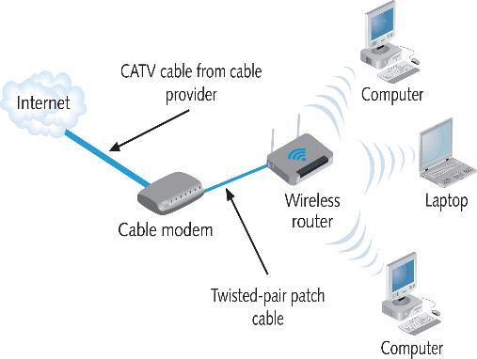
Wireless Benefits (2 of 2)
Figure 4-20 A typical home wireless network

Slide 41
Types of Wireless Networks
Wireless networks can be subdivided into the following categories:
Local area networks (LANs)—usually provides connectivity for mobile users or across areas that couldn’t otherwise be networked
Extended LANs—usually used to increase a LAN’s span beyond normal distance limitations
Internet service—used to bring Internet access to homes and businesses
Mobile computing—users communicate by using a wireless networking medium which enables them to move while remaining connected to a network

Slide 42
Wireless LAN Components
A network interface includes an antenna, which converts outgoing digital signals into radio waves and vice versa
An access point (AP) includes an antenna and a transmitter/receiver device to send and receive wireless traffic
It also connects to the wired side of the network
This connection enables the device to move network data back and forth between a network’s wired and wireless sides

Slide 43
Wireless LAN Transmission (1 of 2)
Wireless communications depends on sending and receiving signals broadcast through the air to carry information
These signals take the form of radio waves in the electromagnetic (EM) spectrum
The frequency of the wave forms used for communication is measured in cycles per second, usually expressed as hertz (Hz)
Lower-frequency transmissions can carry less data more slowly over longer distances, and higher-frequency transmissions can carry more data faster over shorter distances

Slide 44
Wireless LAN Transmission (2 of 2)
The following are common frequencies for wireless communication:
Traditional radio—10 KHz to 300 MHz
Microwave—300 MHz to 300 GHz
Infrared—300 GHz to 400 THz (terahertz)
Higher frequency signals have higher bandwidth potential, but travel shorter distances and have a harder time traveling through obstacles
Lower frequency signals have lower bandwidth potential, but travel longer distances and travel better through obstacles

Slide 45
LAN Media Selection Criteria (1 of 3)
When choosing between media types, consider:
Bandwidth—Higher bandwidth means more expensive cable and higher installation costs
Budget—A typical UTP cable installation cost $100-$200 per cable run and fiber-optic might cost twice that much
Environmental considerations—How electrically noisy is the environment? How important is data security?

Slide 46
LAN Media Selection Criteria (2 of 3)
When choosing between media types, consider (continued):
Span—What kind of distance must the network span?
Longer spans might require fiber-optic or wireless be used between buildings
Existing cable plant—For an upgrade, the existing cable plant must be considered

Slide 47
LAN Media Selection Criteria (3 of 3)
Table 4-5 Comparison of LAN media characteristics
Type | Maximum cable length | Bandwidth | Installation | Interference | Cost
UTP | 100 m | 10-10,000 Mbps | Easy | High | Cheapest
STP | 100 m | 16-10,000 Mbps | Moderate | Moderate | Moderate
Fiber optic | 2-100 km | 100 Mbps – 100 Gbps | Moderate | None | Most expensive
Wireless | 100-300 feet | 11 Mbps – 46 Gbps | Easy | Moderate | Moderate for APs, none for physical media

Slide 48
Knowledge Check Activity 4-2
Under which circumstance should only fiber-optic cabling be used for Ethernet applications?
a. 90-meter cable segment running at 10 Gbps
b. Any connection speed over 1 Gbps
c. 200-meter cable segment running at 1 Gbps
d. All 10 Gbps connections

Slide 49
Knowledge Check Activity 4-2: Answer
Under which circumstance should only fiber-optic cabling be used for Ethernet applications?
Answer: c. 200-meter cable segment running at 1 Gbps
Explanation: Since copper cable segments have a maximum length of 100 meters, any segments longer than 100 meters should use fiber-optic cabling.

Slide 50
Self Assessment
Name some examples of where using fiber-optic cabling would be a better choice over using twisted-pair cabling.
When would you need to use a crossover cable as opposed to a straight-through cable?

Slide 51
Summary
Now that the lesson has ended, you should be able to:
Define the primary cable types used in copper network cabling
Describe the characteristics of the major types of fiber-optic network cabling
Explain the technologies used for wireless networking
Select the proper media for a given application
https://www.yout-ube.com/watch?v=P_188oMgfuQ
Home Network …

